Slide 1
Graph Theory
Shortest Path Algorithm

Slide 2
Shortest Path Algorithm: Dijkstra Algorithm
Dijkstra’s Shortest Path Algorithm is an algorithm used to find the shortest path between two nodes of a weighted graph.
It is a single-source shortest path algorithm. Here, single-source means that only one source is given, and we have to find the shortest path from the source to all the nodes.

Slide 3
Steps:
mark all nodes as unvisited
picked the starting node with a current distance of 0 and the rest nodes with infinity
Now, fix the starting node as the current node,
For the current node, analyze all of its unvisited neighbors and measure their distances by adding the current distance of the current node to the weight of the edge that connects the neighbour node and current node
Compare the recently measured distance with the current distance assigned to the neighbouring node and make it as the new current distance of the neighbouring node,
After that, consider all of the unvisited neighbours of the current node, mark the current node as visited,
If the destination node has been marked visited then stop, an algorithm has ended, and
Else, choose the unvisited node that is marked with the least distance, fix it as the new current node, and repeat the process again from step 4.

Slide 4
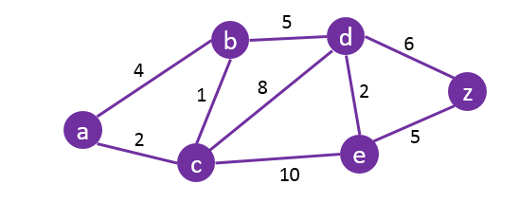
Find the shortest path from A to Z.

Slide 5
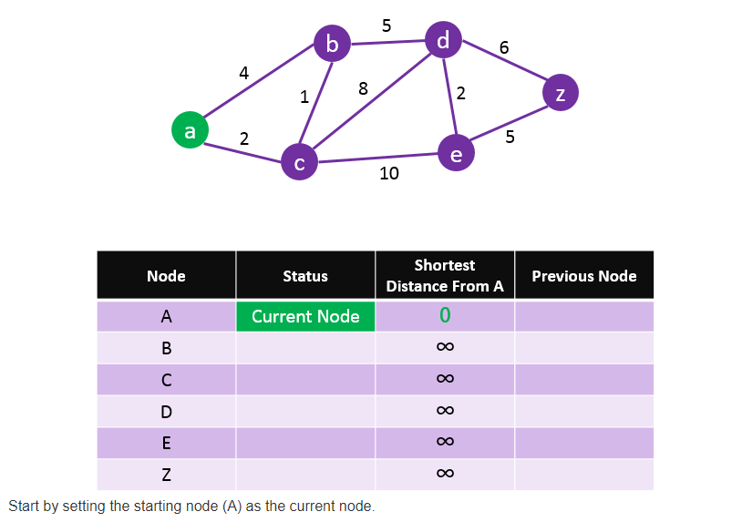

Slide 6
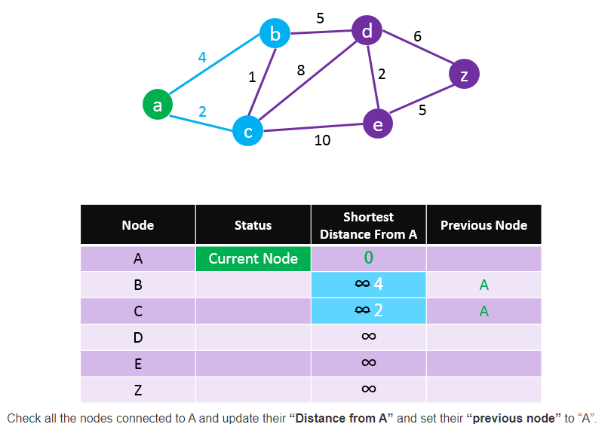

Slide 7
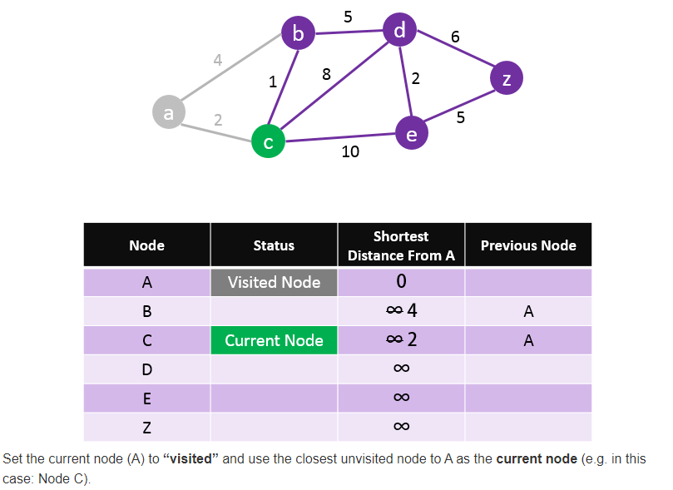

Slide 8
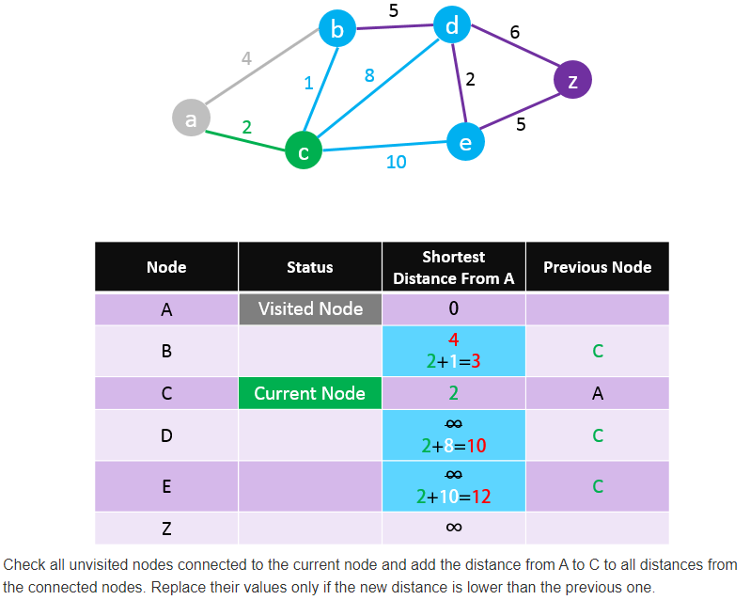

Slide 9
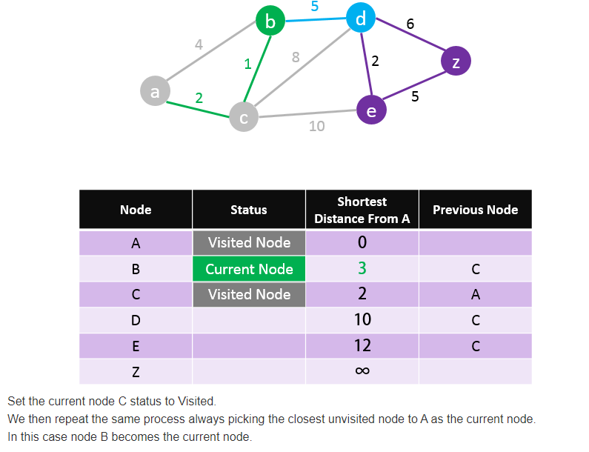

Slide 10
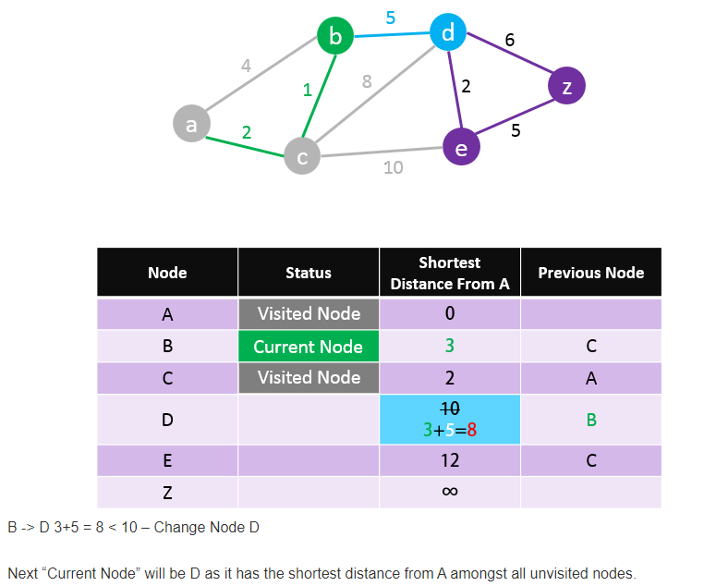

Slide 11
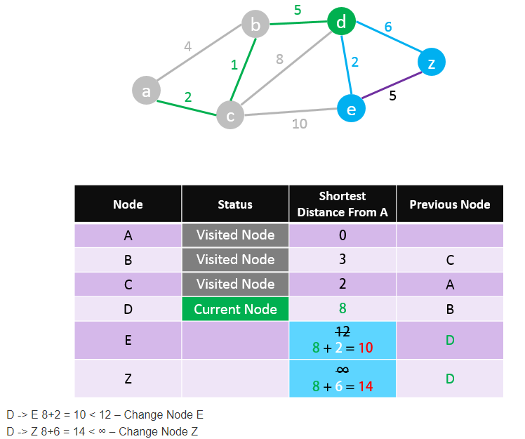

Slide 12
We found a path from A to Z but it may not be the shortest one yet. So we need to carry on the process.
Next “Current Node”: E

Slide 13
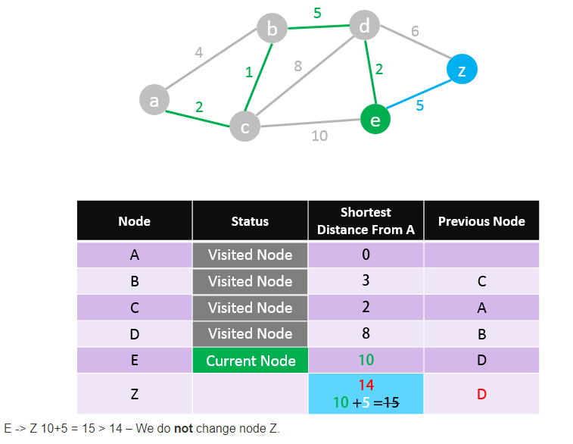

Slide 14
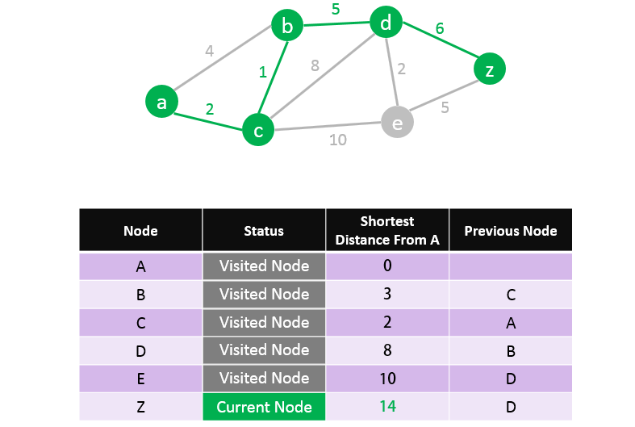

Slide 15
We found the shortest path from A to Z. Read the path from Z to A using the previous node column: Z > D > B > C > A So the Shortest Path is: A – C – B – D – Z with a length of 14

Slide 16
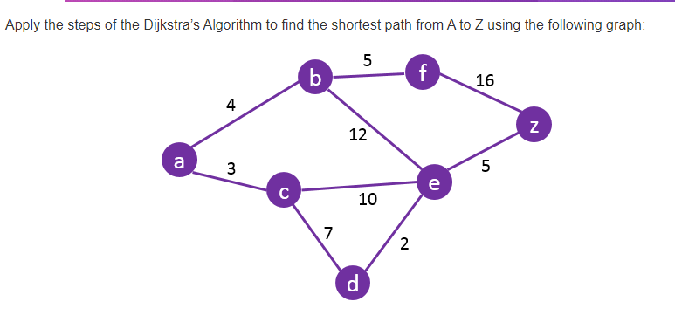
Question

Slide 17
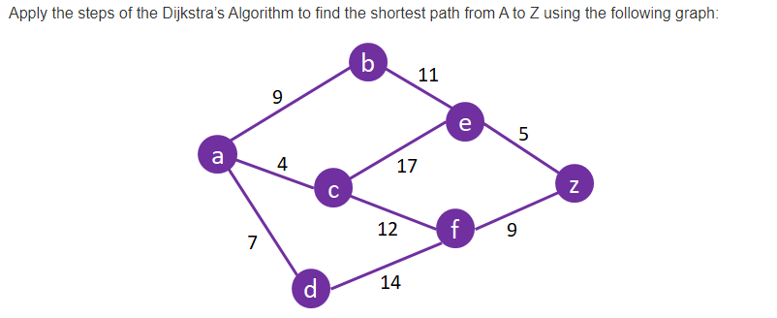
Question

